Slide 1

Repetition and Learning in Games (pt 1)
Chris Kiekintveld

Slide 2
Repeated Games
Play the same normal-form game over and over
each round is called a “stage game”
Questions we'll need to answer:
what will agents be able to observe about others' play?
how much will agents be able to remember about what has happened?
what is an agent's utility for the whole game?

Slide 3
Finitely Repeated Games
Everything is straightforward (in a sense) if we repeat a game a finite number of times
We can write the whole thing as an extensive-form game with imperfect information
at each round players don't know what the others have done; afterwards they do
overall payoff function is additive: sum of payoffs in stage games

Slide 4
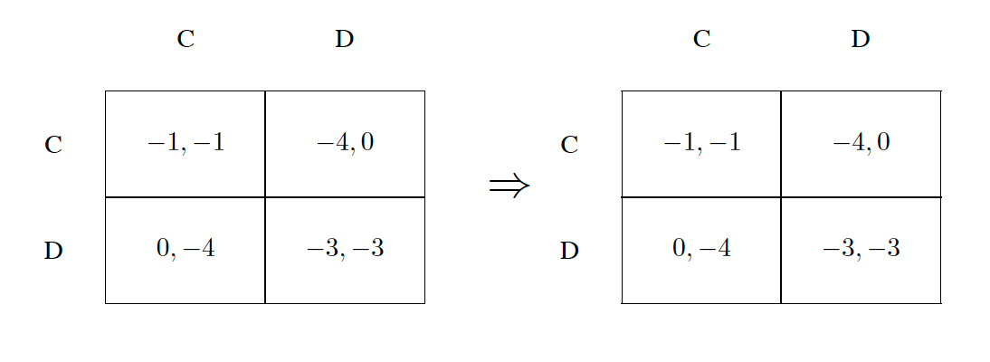
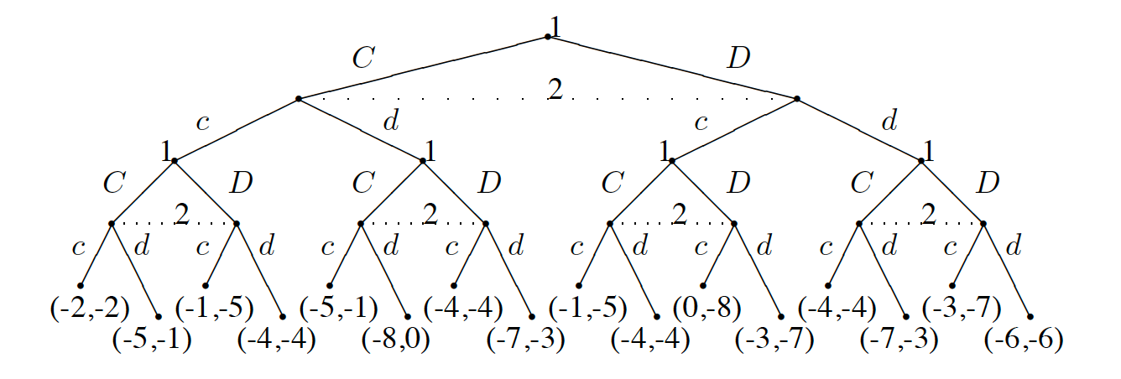
Repeated PD

Slide 5
Notes
Observe that the strategy space is much richer than it was in the NF setting
Repeating a Nash strategy in each stage game will be an equilibrium in behavioral strategies (called a stationary strategy)
In general strategies adopted can depend on actions played so far
We can apply backward induction in these games when the normal form game has a dominant strategy.

Slide 6
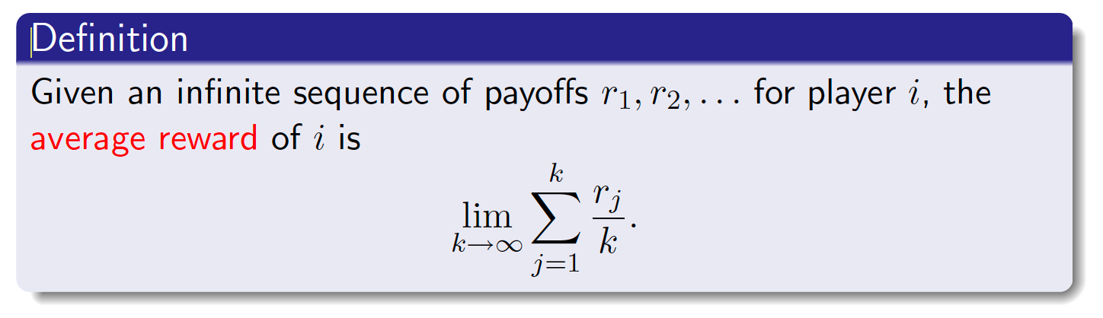
Infinitely Repeated Games
Consider an infinitely repeated game in extensive form:
an infinite tree!
Thus, payoffs cannot be attached to terminal nodes, nor can they be defined as the sum of the payoffs in the stage games (which in general will be infinite).

Slide 7
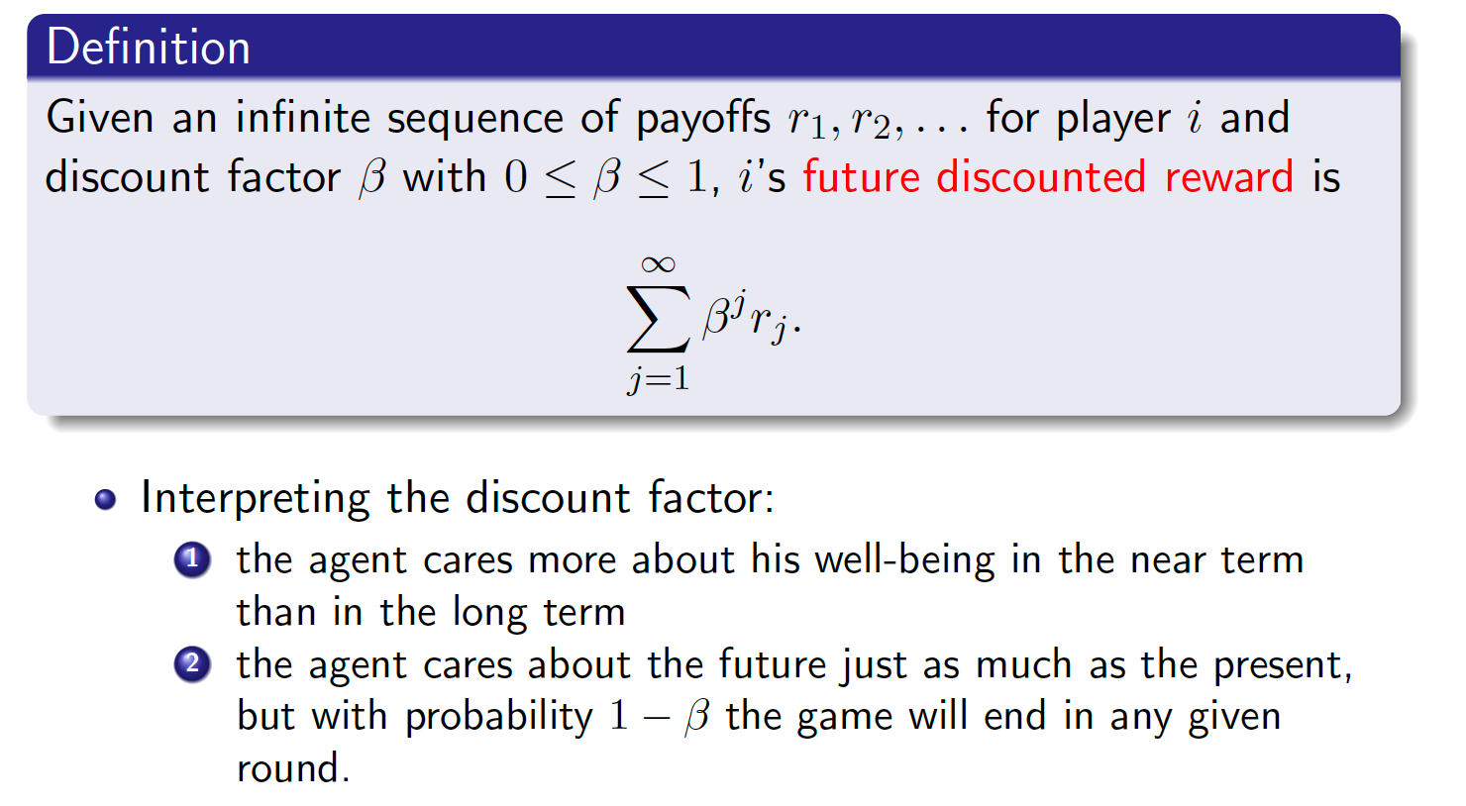
Discounted Reward

Slide 8
Strategy Space
What is a pure strategy in an infinitely-repeated game?
a choice of action at every decision point
here, that means an action at every stage game
...which is an infinite number of actions!
Some famous strategies (repeated PD):
Tit-for-tat: Start out cooperating. If the opponent defected, defect in the next round. Then go back to cooperation.
Trigger: Start out cooperating. If the opponent ever defects, defect forever.

Slide 9
Nash Equilibria
With an infinite number of equilibria, what can we say about Nash equilibria?
we won't be able to construct an induced normal form and then appeal to Nash's theorem to say that an equilibrium exists
Nash's theorem only applies to finite games
Furthermore, with an infinite number of strategies, there could be an infinite number of pure-strategy equilibria!
It turns out we can characterize a set of payoffs that are achievable under equilibrium, without having to enumerate the equilibria.

Slide 10
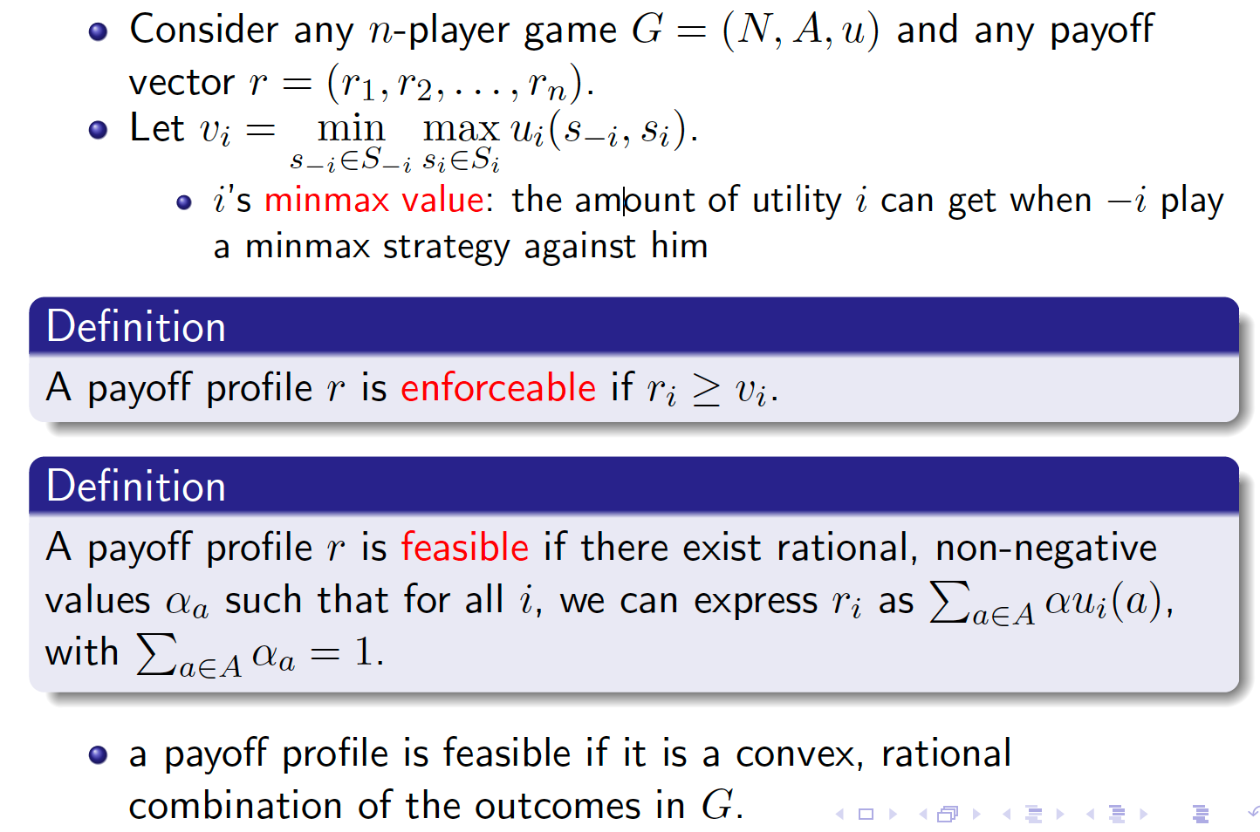
Definitions

Slide 11
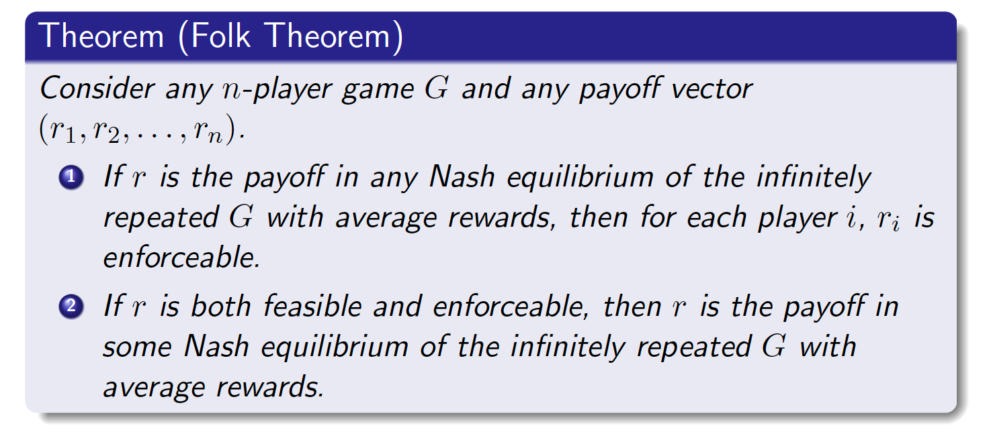
Folk Theorem

Slide 12
Stochastic Games
What if we didn't always repeat back to the same stage game?
A stochastic game is a generalization of repeated games
agents repeatedly play games from a set of normal-form games
the game played at any iteration depends on the previous game played and on the actions taken by all agents in that game
A stochastic game is a generalized Markov decision process
there are multiple players
one reward function for each agent
the state transition function and reward functions depend on the action choices of both players

Slide 13
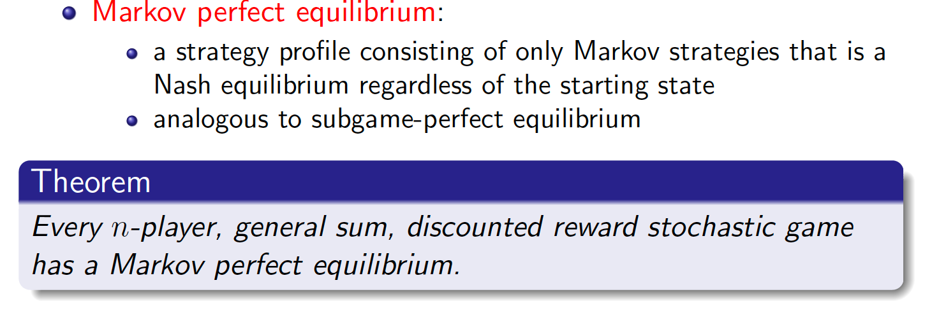
Equilibrium in Stochastic Games

